Slide 1


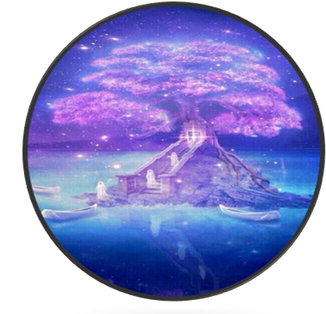
MaSakura
Presentation by:
Zi Wei (Cheemay) Song & Precious Deremo

Slide 2

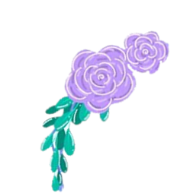
Introduction: MaSakura Origins
The title was chosen on a name generator website that we used, after we struggled to finalise a name.
Our project is centered upon the development of a software system for the industrial sector “Entertainment”.
Inspired by our shared love for this genre of entertainment we decided to create a software tool to provide some more conveniences to our enjoyable hobby.

Slide 3
Our Research
Our survey questions were tailored to people who enjoyed anime/manga as it was our main demographic of users for this product.
We found that 18.9% have struggled with recommending since they may have lost track of how many they watched or what they viewed. We believed an innovative idea to combat their struggle would be having a share option in our design which could allow users to share their lists as a link for other users to view.
We chose to use extensions as our product, as the idea required Google Sync to function. We found that they are also simple to install. Extensions are small software programs that customize the browsing experience. They enable users to tailor Chrome functionality and behavior to their individual needs or preferences.

Slide 4
User Stories and UML Diagrams
Our user stories were inspired by typical anime/manga lovers.
In other words, we looked at our product through the eyes of typical users to generate relatable user stories to back up our core research and prototype design. Enjoying the same type of entertainment really helps us with our design.
Our UML Diagrams were made to be presented to each stakeholder including customers and software designers.
Use Case: Use Case Summary diagram to represent all the user stories presented to the customers and companies.
Sequence Diagram: Detailed user sequence diagrams for each user story presented to the project managers.
Class Diagram : Separated into two main diagrams with centered points presented to project managers and companies.
Architectural Diagram: Diagram of the MaSakura operations and functions presented to the software designers.

Slide 5
Mock-Up Design
We gathered beautiful images to use as background and logo designs. All images were found on Pinterest for the mock-up.
The reason we chose to use a web design for our extension was because extensions are typically used on laptops or computers. However, an article on ‘makeuseofus’ Titled ‘How to use chrome extensions on Android’ by Denis Manyinsa (https://www.makeuseof.com/chrome-extensions-android-mobile/) detailing how android users could use Chrome extensions, though it requires a longer process.
To avoid inconveniencing our users we decided that we would create a pre-mature mobile version of our design. Designs for both mock-ups were created on Balsamic Wireframes.

Slide 6
System Tests and Conclusion
We defined all the user requirements we believed we needed to test out. Our system tests take our user stories into account and present the testing stages clearly. Our user requirements were influenced by our user stories as well as our own personal experiences with web browsing applications.
Our goal for the system tests was to showcase MaSakura’s simple access to the necessary features such as the links to the user’s site and their recommendations page.
Many participants enjoyed the idea of the ‘MaSakura’ extension as a way for them to explore new anime/manga in a simple cohesive manner. The main idea is to provide convenient features to overcome niche requirements.
In addition, MaSakura may open gateways to participants who may be interested in watching anime/reading manga but might not know where to start browsing. This opportunity would also promote the beauty of Japanese culture through engaging visual learning, while expanding the perspectives of a new audience.

Slide 7
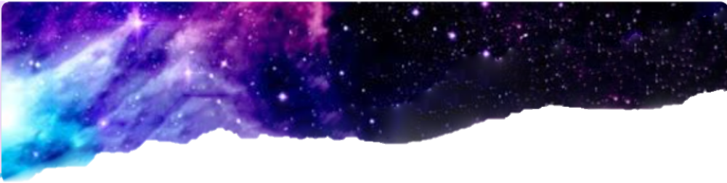
Thank You For Your Attention!

